Slide 1

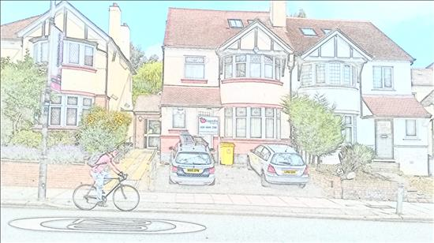
Patient Participation Group
Saturday 30 January 2016
DIABETES

Slide 2
Welcome & Introductions
Thank you for joining us today
A warm welcome to:
  patients attending the PPG for the first time
  members from Grosvenor Road Surgery PPG (following our merger)
  guest from health service in Turkey
Apologies from those who are unable to make it here

Slide 3
Programme
Part 1
Diabetes – the problem
  How big is the problem?
  What we are doing about it, and why
  Will others get it too? (the answer is Yes)
Part 2
Healthy eating in practice
Discussion about our services

Slide 4

Please note:
Keep comments constructive
Feel free to make notes, or take snapshots of the slides
Slides on www.alexandrasurgery.com and on Facebook
Welcome to take photos of the meeting, but please respect others before you publish in any media

Slide 5
Part 1
DIABETES: THE PROBLEM

Slide 6
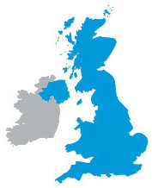

How big is the problem (1)
Increasing number of people with diabetes
1996 | 2015 | 2025 (projected)
1,400,000 (2.4%) | 3,453,034 (5.3%) | 5,000,000 (7.2%)
 | + 549,000 ?
2000 | 2030
171,000,000 (2.8%) | 366,000,000 (4.4%)

Slide 7


How big is the problem (2)
Alexandra Surgery
Age
Registered patients | Diabetes
6,367 | 366 (5.7%)
141 | 215
10-19 | 20-29 | 30-39 | 40-49 | 50-59 | 60-69 | 70-79 | 80-89 | 90-99 | 100+
3 | 4 | 8 | 48 | 72 | 94 | 74 | 46 | 6 | 1

Slide 8
What we do about it and why (1)
Alexandra Surgery looks after patients with:
Type 1 diabetes
Type 2 diabetes life long conditions
Gestational diabetes
Pre-diabetes may become Type 2

Slide 9
What we do about it and why (2)
Check at least annually:
Support:
HbA1c blood test * more reliable than glucose | Kidney function blood test
Blood pressure | Urine albumin test
Cholesterol blood test | Feet examination: skin, blood circulation, nerve function
Eye screening | Weight
Smoking cessation | Individual targets
Medication review | Education course
Related issues (impotence) | Referral for specific problems

Slide 10
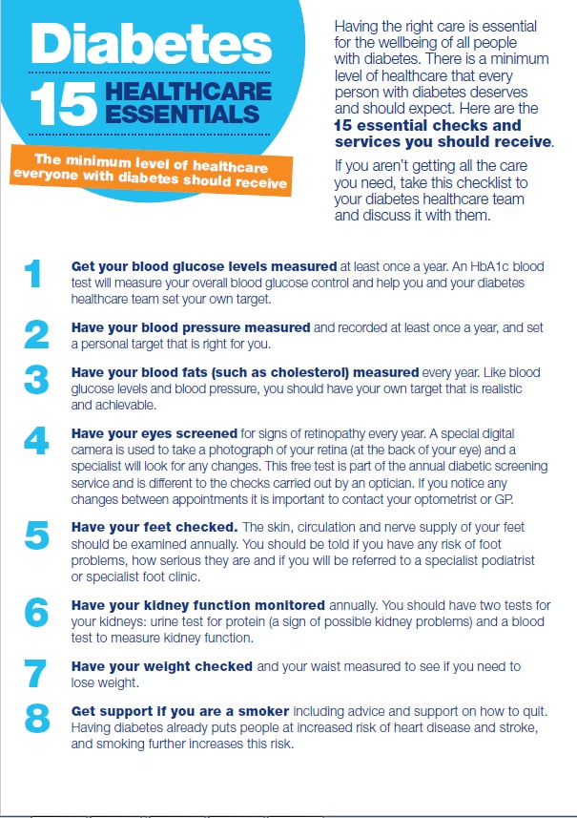
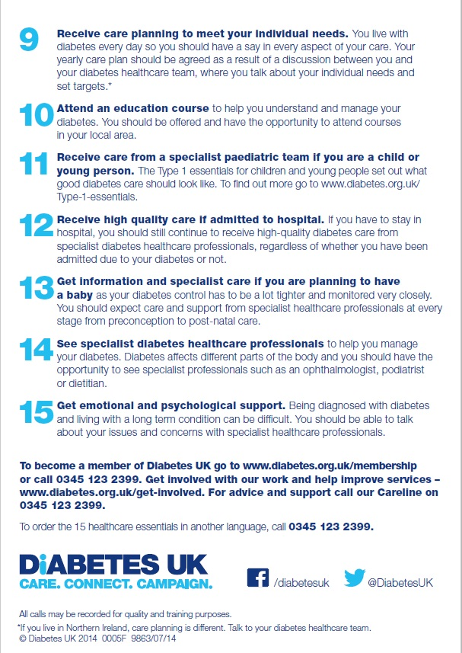
What we do about it and why (3)
Based on standards set out for professionals

Slide 11
What we do about it and why (4)
Medical research showed:
[1] UKPDS study
[2] Oxford review of 40 trials
[3] Multi risk factor intervention trial
Change | Benefit
Lower HbA1c by 1% [1] | Lower risk of diabetes related death by 21% Lower risk of micro-vascular complications by 37%
Lower BP by 10 mmHg [2] | Lower risk of death by 11-17% Lower risk of stroke by 27%
Lower Cholesterol by 1 mmol [3] | Lower risk of coronary disease by 50%

Slide 12
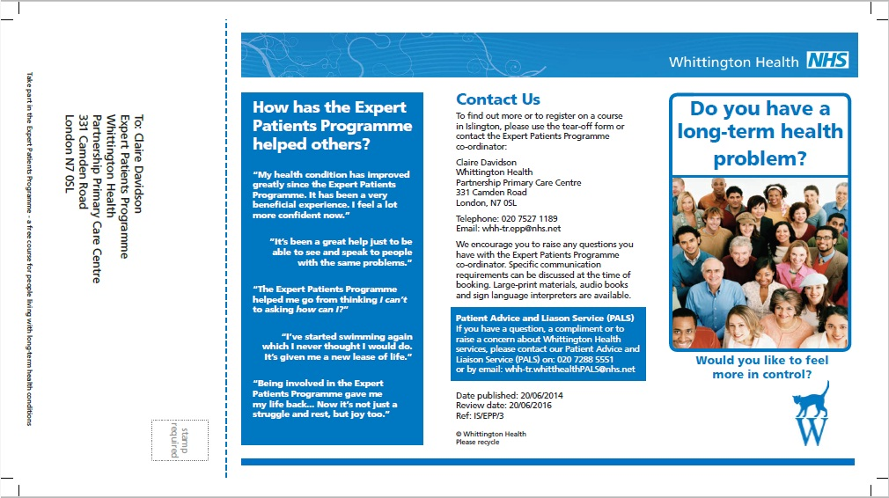
What we do about it and why (5)
Expert Patient Programme (EPP)

Slide 13
Will others get it too (1)
You don’t have diabetes at present
Your family/ friends don’t have diabetes now
You had transient diabetes during pregnancy
Will you/ they become diabetic later?

Slide 14
Will others get it too (2)
Pre-diabetes (IFG, impaired fasting glycaemia/ IGT, impaired glucose tolerance)
Research in UK:
35.3% adults have Pre-diabetes
5-10% will develop Type 2 diabetes every year
 | Normal | Pre-diabetes | Diabetes
HbA1c (mmol/mol) | 41 or lower | 42-47 | 48 or higher
HbA1c (%) | 5.9 or lower | 6.0-6.4 | 6.5 or higher

Slide 15
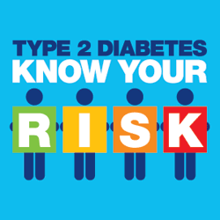
Will others get it too (3)
Alexandra Surgery
Pre-diabetes may have no symptoms, only show up if tested
Risk of getting diabetes:
http://riskscore.diabetes.org.uk/
1. no we cannot change, e.g. age
2. yes we can do something about, e.g. girth
Jan 2014 | Jan 2015 | Jan 2016
105 | 136 | 155

Slide 16
Will others get it too (4)
Risk factors for diabetes
Overweight
Large waist (women over 31 in, men over 37 in)
Afro-Caribbean, Black African, Chinese, South Asian
Age over 40
Parent, brother or sister with diabetes
History of high blood pressure, heart attack, stroke
History of polycystic ovaries, gestational diabetes, baby over 10 lb (4.5 kg)
History of schizophrenia, bipolar illness, depression

Slide 17
Will others get it too (5)
Gestational diabetes
  3rd trimester of pregnancy
  18% pregnant women in England & Wales
  usually disappear after birth
  more likely to develop Type 2 diabetes later

Slide 18
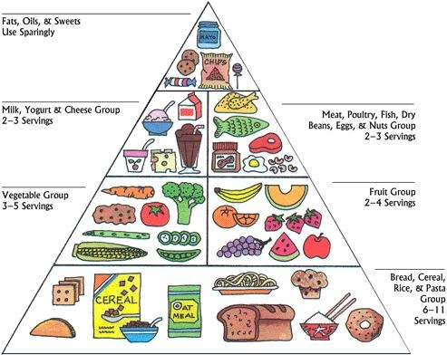

Will others get it too (6)
Prevention of diabetes: Lifestyle changes
Healthy balanced diet
Physically active
Avoid over-weight

Slide 19
Part 2
DIABETES: FINDING A WAY FORWARD TOGETHER

Slide 20

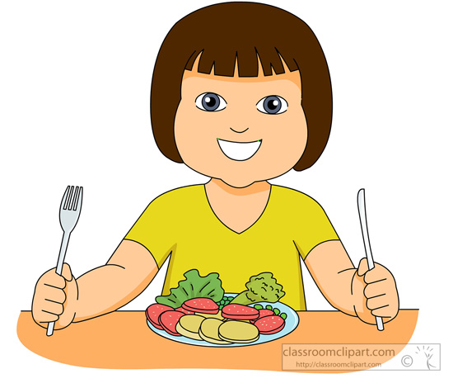
Group discussion
How can our team ensure you receive the check ups?

Slide 21
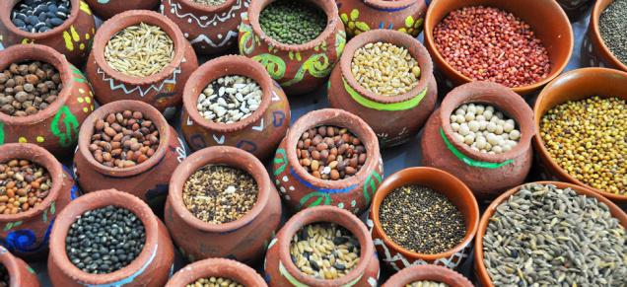
Healthy eating in practice
Millets

Slide 22
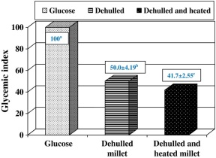
Millets
Nutrition composition
10.5% protein, 3.6% fat, 68.8% carbohydrate.
398 kcal/100 g energy.
Total dietary fibre content (12.6%) including soluble (4.2%) and insoluble (8.4%) fractions.
Effect (after 28 days)
Glucose ⬇
LDL cholesterol ⬇
Glycemic index and significance of barnyard millet
(Echinochloa frumentacae) in type II diabetics.
Ugare R, Chimmad B, Naik R, Bharati P, Itagi S.
J Food Sci Technol. 2014 Feb;51(2):392-5.

